Slide 1

Citizen Suite
Unifying Ecosystem for Seamless Civic Experience

Slide 2
Contents
Introduction
System overview
Admin Roles
Workflow
User verification and security
API integration
Future Enhancements
Conclusion

Slide 3
Introduction
Problem statement:
Welcome to Citizen Suite, an innovative project designed to tackle the challenges posed by managing separate applications for various civic functions.
The problem arises from dependencies between different organizations, causing delays in tasks and a lack of real-time updates.

Slide 4

Solution offered:
Citizen Suite addresses these challenges by providing a single, unified platform that serves as a comprehensive solution to meet diverse civic needs.
With Citizen Suite, users gain the convenience of a centralized point of contact for all their requirements, eliminating the hassles of navigating multiple applications.
The system's real-time updates ensure seamless workflow, fostering a more efficient and interconnected civic experience.
Let's explore how Citizen Suite transforms the civic landscape by providing a holistic, user-friendly, and cost-effective platform for both citizens and government entities.

Slide 5

System overview

Slide 6
Citizens now access all their day-to-day needs through one application, eliminating the need to navigate multiple platforms.
Event Management: Enables the creation and approval of event locations, registration, and organization coordination.
Education: Facilitates the addition and approval of courses and universities, ensuring a streamlined education system.
Finances: Safely stores card details for secure transactions, facilitating hassle-free event bookings.
City Planning Commission: Provides a platform for informed decision-making regarding city planning.
Government Oversight: Centralizes data from all departments, offering comprehensive insights.

Slide 7

Benefits of Integration:
Time Savings: Citizens now access all their day-to-day needs through one application, eliminating the need to navigate multiple platforms.
Effort Reduction: Streamlined processes for event management, education, finances, and city planning reduce the effort required for citizens and authorized personnel.
Cost Efficiency: The consolidation of functions into a single platform reduces maintenance costs associated with managing separate applications.
Government Access:
Government entities can now efficiently access information from different departments through a single application, enhancing data visibility and decision-making.
Citizen Convenience:
Citizens no longer need to search for and navigate through various applications. All their requirements are conveniently consolidated within Citizen Suite.

Slide 8
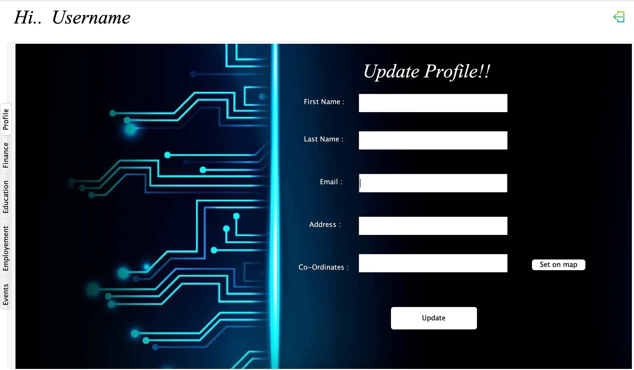
Admin Roles

Slide 9
System Admin:
Responsibilities:
Master access to the system with the authority to add venues, events, universities, courses, and companies.
Creation of other admins for various departments.
Permissions:
Full control over system configurations and user management.
Government Admin:
Responsibilities:
Oversight of all applications related to event handling, building approvals, and course approvals.
Permissions:
Access to comprehensive data for decision-making.
Approval or rejection of applications submitted by citizens and enterprises.
Censor Admin:
Responsibilities:
Control over approving events based on audience appropriateness (adults, kids, all).
Permissions:
Decision-making authority on event approvals.
City Commissioner:
Responsibilities:
Management of building-related applications for companies, events, and universities.
Permissions:
Approval or rejection of applications submitted for building-related matters.
Credit Card Admin:
Responsibilities:
Management of the finances of the current user.
Permissions:
Access to user financial data.
Authorization for financial transactions related to event bookings.

Slide 10

Workflow

Slide 11

Venue Listing:
Venue Coordinator lists potential venues and their timelines.
Approval Process:
City Commissioner approves or rejects venue submissions.
Event Booking:
Event Organizer books approved venues for events.
User Booking:
Users book events using credit card details stored in the application.
Government Oversight:
Government Admin oversees all events, gaining valuable insights for well-informed decision-making in future projects.

Slide 12

University Creation:
University Coordinator uses approved buildings to create universities.
Approval Process:
City Commissioner approves or rejects university submissions.
Course Addition:
Course Creator adds courses to approved universities.
Student Enrollment:
Students enroll in courses offered by approved universities.
Government Oversight:
Government Admin has visibility into education-related activities, aiding in informed decision-making for future projects.

Slide 13

User verification & security

Slide 14

User Verification:
Password Hashing:
Ensuring user security is paramount in Citizen Suite.
Passwords are securely hashed to protect user credentials.
Advanced hashing techniques are employed to safeguard sensitive information.
Email Authentication:
During the registration process, an additional layer of security is implemented through email verification.
A one-time password (OTP) is sent to the registered email address.
Users must input the OTP to complete the registration process, ensuring the authenticity of user accounts.

Slide 15

Benefits:
Enhanced Security:
Password hashing adds an extra layer of protection against unauthorized access.
Email authentication strengthens user identity verification.
User Confidence:
With robust security measures in place, users can confidently utilize Citizen Suite for their day-to-day needs.
User Experience:
Seamless Registration:
The registration process is user-friendly, with email OTP verification offering a hassle-free and secure experience.
Conclusion:
Citizen Suite prioritizes user safety, implementing cutting-edge security features like password hashing and email authentication.
Users can trust that their information is safeguarded, contributing to a secure and reliable civic interaction platform.

Slide 16

API integration

Slide 17
Java Email API:
Purpose:
Used for sending OTP and verifying users during the registration process.
Benefits:
Securely facilitates user verification through email authentication.
Enhances the registration process by ensuring the authenticity of user accounts.
Google Maps API:
Purpose:
Enables precise location tracking for venue approval.
Provides users with event locations on an interactive map.
Benefits:
Streamlines the approval process by accurately locating venues.
Enhances user experience by visualizing event locations on the map.
JX Browser for Video Playing:
Purpose:
Facilitates the playback of video files through URLs specified in the event section.
Benefits:
Offers seamless integration for video playback within the application.
Enhances the multimedia experience during event exploration.

Slide 18
Unit Testing
Utilized Java Faker API to generate realistic and diverse sample data.
Streamlined the testing process by automating the creation of test data.
Ensured that the application functions reliably under various scenarios.
Sample Data Used:
Companies:
Simulated the presence of diverse companies within the system for testing enterprise functionalities.
Credit Card Information:
Employed synthetic credit card details to assess the reliability of financial transactions.
User Information:
Generated sample user data to test various user-related functionalities.
Advantages of Java Faker API:
Realism:
Provides realistic and diverse sample data for testing purposes.
Efficiency:
Streamlines unit testing by automating the creation of test scenarios.
Customization:
Allows customization of data to simulate a wide range of scenarios.
Ensuring Reliability:
Thorough Testing:
The use of Java Faker API ensures that Citizen Suite has been rigorously tested under various conditions.
Guarantees the reliability and robustness of the application.

Slide 19
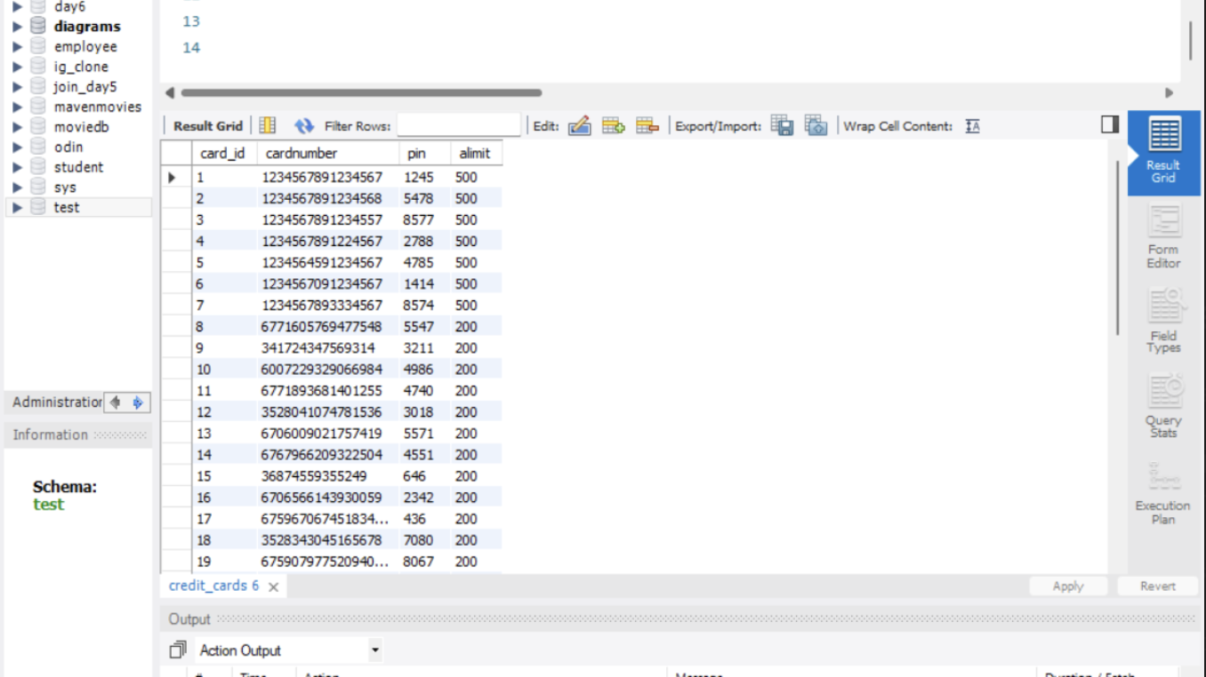
Sample Faker.io data

Slide 20

Future enhancements

Slide 21
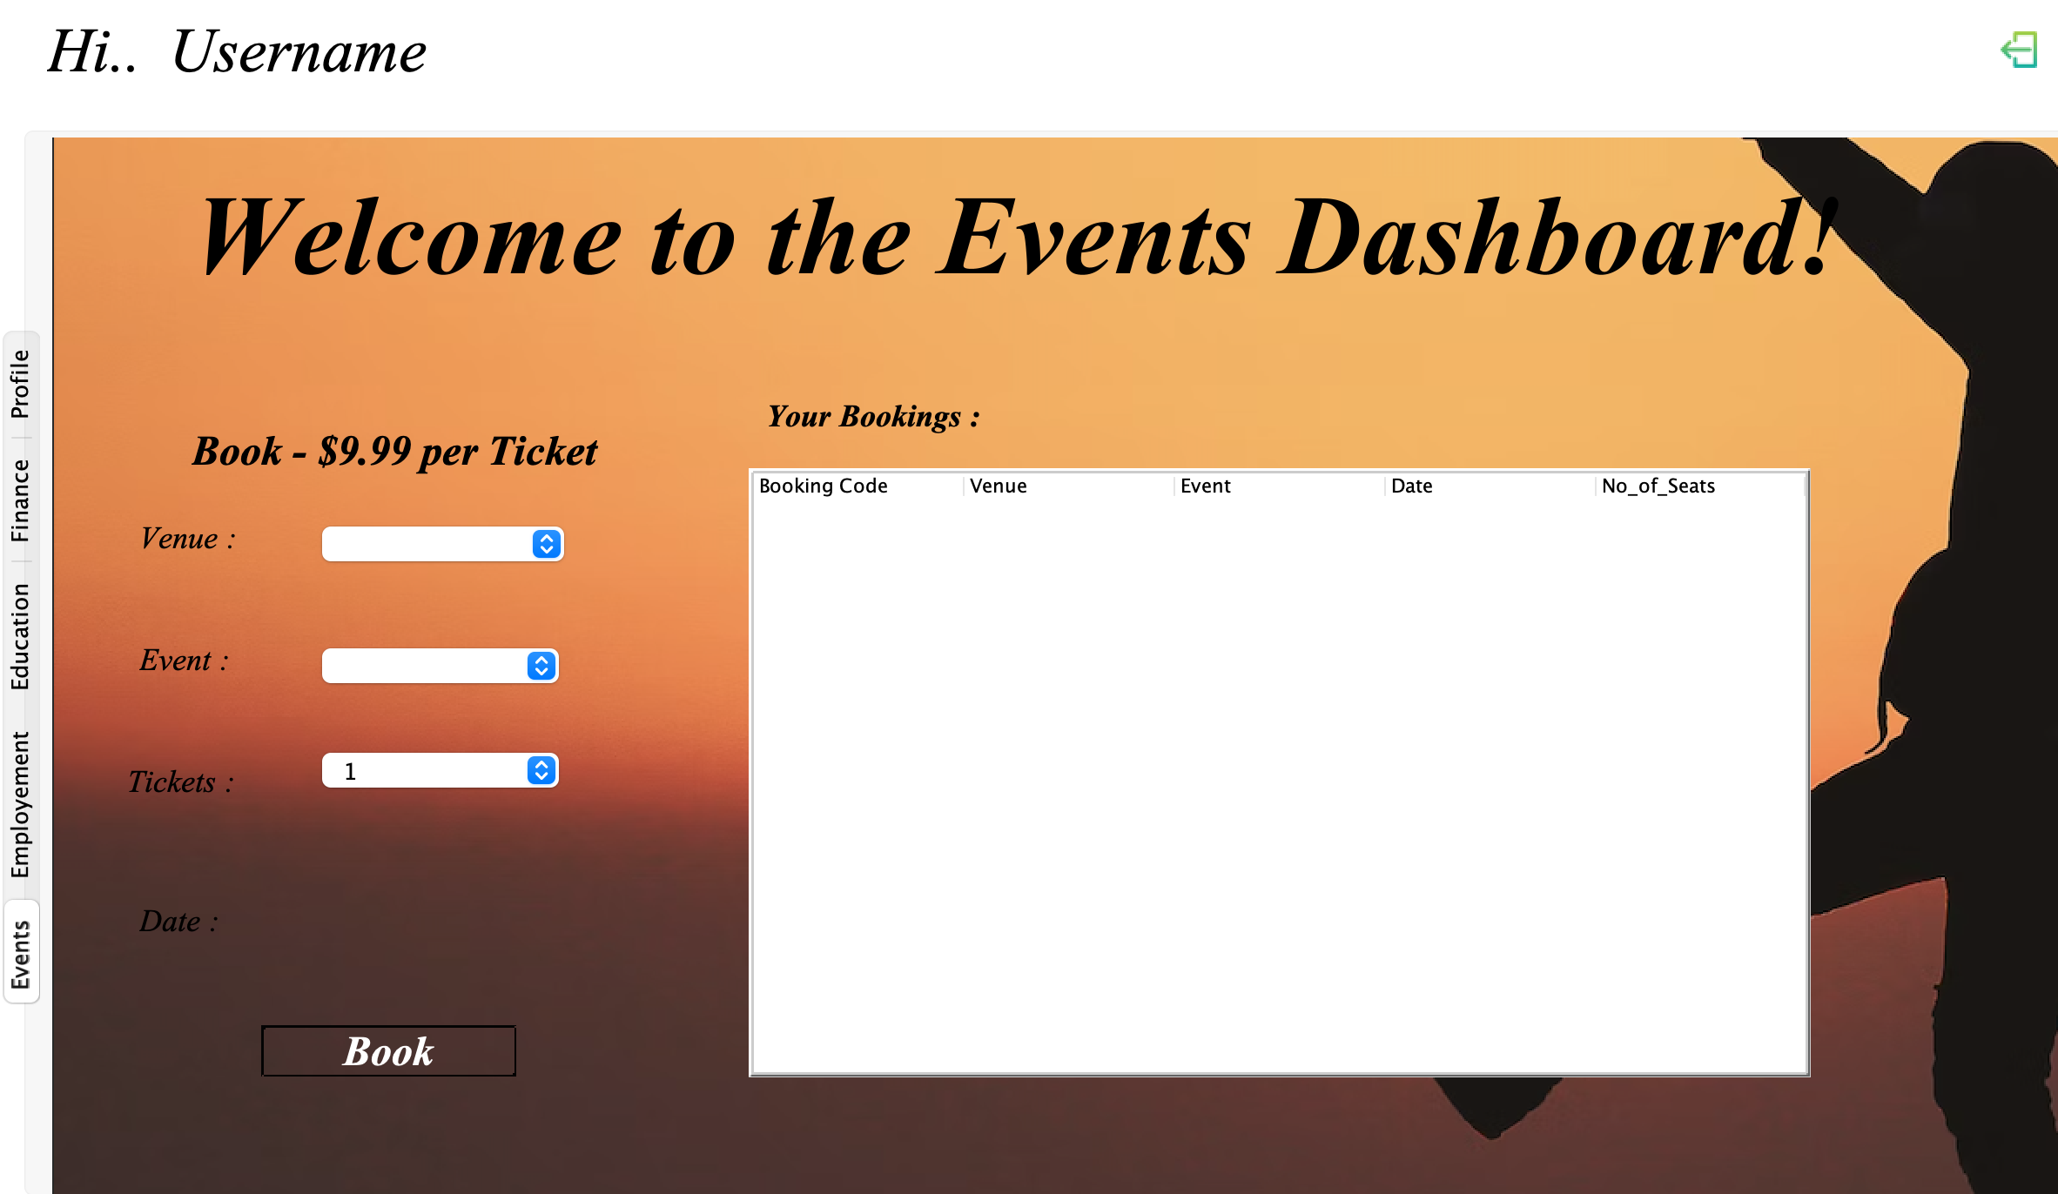
Personalized Analytics:
Vision:
Implement generative AI for real-time analysis and solutions based on user data.
Benefits:
Enhances user experience by providing personalized insights and recommendations.
Optimizes decision-making for administrators through intelligent data analysis.
Expansion of Enterprises:
Objective:
Introduce additional enterprises, such as hospitals and travel, into Citizen Suite.
Benefits:
Broadens the scope of the application, making it a comprehensive civic interaction platform.
Offers users a centralized hub for an even wider range of day-to-day needs.
Payment Interface Integration:
Goal:
Implement payment gateways for seamless financial transactions within the application.
Benefits:
Enables users to make secure payments for services, event bookings, and more.
Enhances the financial functionality of Citizen Suite for a holistic user experience.

Slide 22

Conclusion
In conclusion, Citizen Suite emerges as a groundbreaking solution, seamlessly unifying various civic functions within a single, user-friendly platform. By integrating Event Management, Education, Employment, Finances, and Government oversight, we have not only streamlined workflows but also fostered a secure and efficient civic interaction experience. Robust security measures, strategic API integrations, and the use of Java Faker API for unit testing underscore our commitment to reliability and user satisfaction. As we envision future enhancements and expansions, Citizen Suite stands as a testament to modernizing civic engagement, offering citizens and administrators alike a comprehensive, interconnected, and forward-thinking solution for their day-to-day needs.

